Slide 1
Explainability Artificial Intelligence Project
Subtopic : Life Sure Insurance Data Analysis and Recommendations
Presented By :
Siddartha NANUVALA
Devaraj RAMAMOORTHY
Shreeraam BALARAM
Man Vijaybhai PATEL
Edwin JOHNY PAUL
Parth Pareshbhai VENKARIYA

Slide 2
Context
Objective :
Understand customer behaviors, market trends, and sustainability-related choices to enhance insurance policies.
Why it Matters :
Understand customer behaviors, market trends, and sustainability-related choices to enhance insurance policies.
Provide actionable insights for policy innovation and strategic decision-making.

Slide 3

Phase 1 – Data Collection and Integration
Objective:
Gather and integrate external data sources for a comprehensive understanding of customer behaviors and market trends.
Key Steps:
Data Collection:
Identify datasets (market trends, demographics, environmental data, public sentiment).
Ensure datasets cover social, environmental, and customer preferences.
Data Preparation and Cleaning:
Handle missing values, anomalies, and inconsistencies.
Standardize formats for easy integration.
Create new variables (e.g., customer segments, risk scores).
Consolidate into a unified dataset.

Slide 4

Phase 2 – Data Analysis and Specifications
Objective:
Explore trends and correlations in the data to gain insights into customer behavior and needs.
Exploratory Data Analysis (EDA):
Visualize trends using histograms, scatter plots, and time series.
Identify key variables influencing policy selection (age, location, environmental concerns).
Identifying Key Insights:
Segment customers based on sustainability preferences.
Analyze shifts in customer needs over time.
Highlight actionable findings for LifeSure’s strategy.

Slide 5

Phase 3 – Visualization and Communication of Results
Objective:
Present findings in a clear and actionable format for stakeholders.
Dashboard Creation:
Develop an interactive dashboard using tools like Tableau or Power BI.
Highlight critical metrics (customer trends, sustainability choices, demographic breakdowns).
Ensure intuitive design for easy interpretation.
Dashboard Features :
Interactive Filters:
Region, age range, smoker status.
Visualizations:
Bar chart: Average charges by region.
Scatter plot: Age vs. charges, colored by smoker status.
Boxplot: Charges distribution by risk category.
Pie chart: Customer distribution by region.
Heatmap: Correlation between variables.

Slide 6
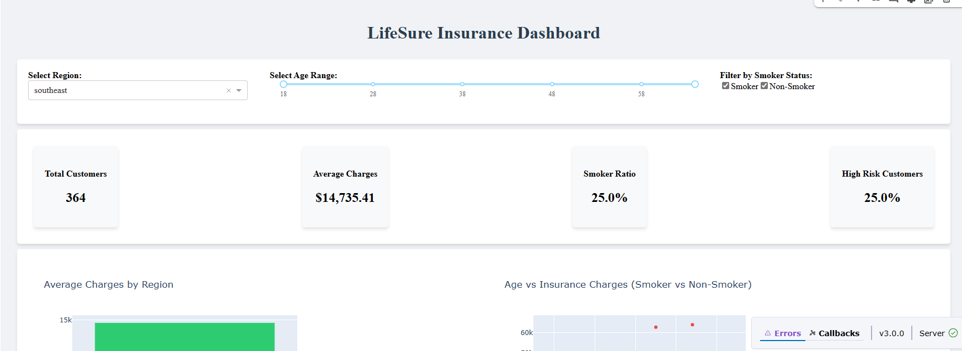
Data Visualization

Slide 7
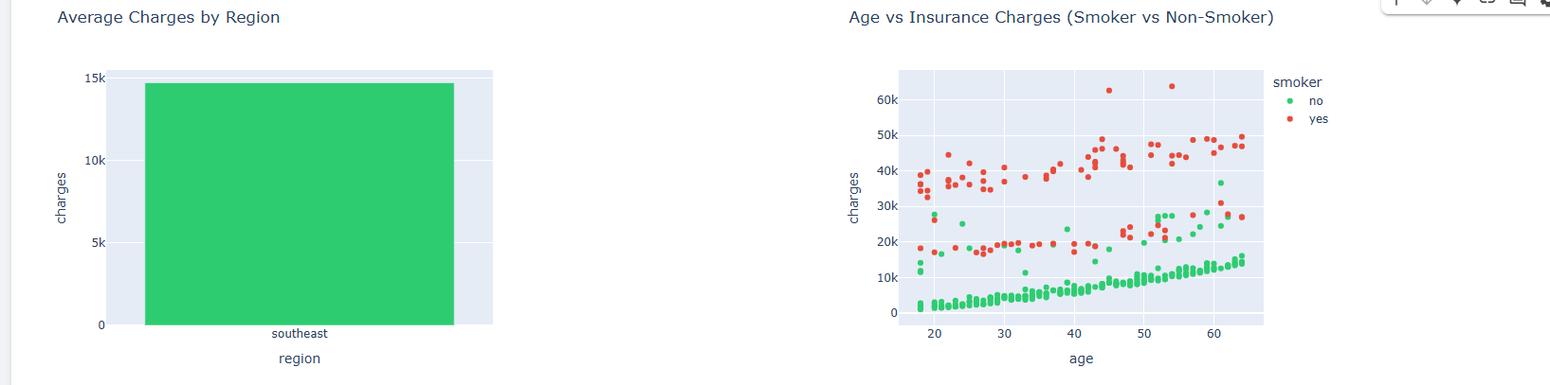
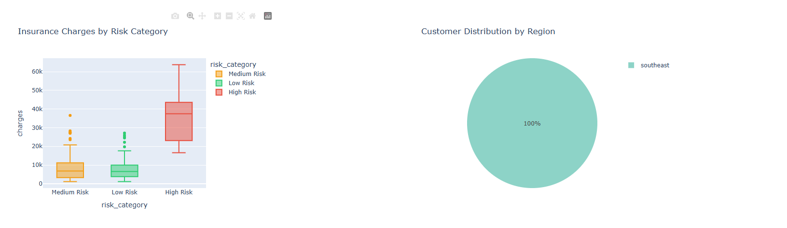

Slide 8
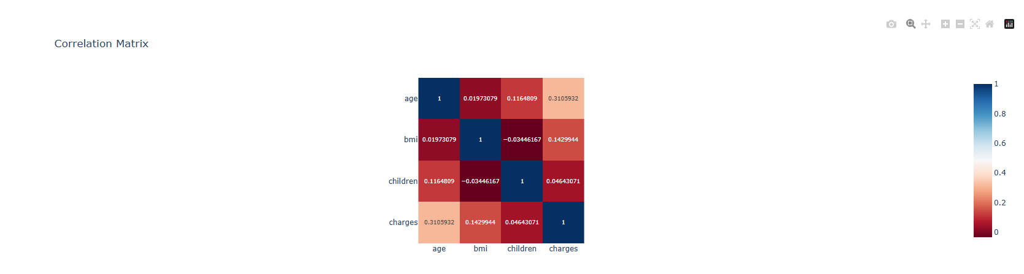

Slide 9
Key Findings
Customer Segmentation:
Regional differences in insurance costs.
High-risk customers (smokers) incur higher charges.
Demographics:
Strong correlation between age, BMI, and charges.
Sustainability Opportunities:
Potential to promote wellness programs for high-risk customers.
Align policies with customer preferences for sustainable options.

Slide 10
Implications for Life Sure
How These Findings Help:
Tailor policies to regional demographics and preferences.
Promote wellness programs to reduce risks and costs.
Highlight sustainability initiatives in marketing campaigns.

Slide 11

Recommendations
Policy Options:
Offer discounts for non-smokers and low-risk customers.
Introduce wellness programs to reduce BMI and smoking rates.
Strategic Initiatives:
Launch marketing campaigns emphasizing sustainability.
Partner with healthcare providers for preventive care services.
Future Steps:
Incorporate additional datasets (environmental data, public sentiment) for deeper insights.

Slide 12
Conclusion
Recap:
Comprehensive data collection, cleaning, and analysis.
Development of an interactive dashboard for actionable insights.
Final Takeaway:
These insights and recommendations can enhance LifeSure’s market competitiveness and commitment to sustainability.

Slide 13
Thank you
Resources
[Insurance Dataset](https://www.kaggle.com/mirichoi0218/insurance)
Git hub link :https://github.com/SiddarthaNanuvala/Life-Sure-Project.
Questions and Discussion

